Slide 1
EHR Information System Project
Information Systems in Health Care (WS23/24)
Rocío Alonso las Heras

Slide 2
INDEX
Introduction
Aim of the project
Frontend
Backend
Evaluation
Questions
uí

Slide 3
INTRODUCTION
1. Basic concepts
Electronic Health Records (EHR)
Overview of healthcare information system development
2. Expected Outcome
Functional and efficient EHR system.
Intuitive, user-friendly design.
Contribution to improved healthcare information management.
01

Slide 4
AIM OF THE PROJECT
Develop EHR system from scratch.
Doctor-centric approach.
Emphasis on team's manual system construction.
Integration of specific technologies (HTML 5, Bootstrap 5, PHP, MySQL).
02

Slide 5
FRONTEND
Definition: The frontend, also known as the client-side, refers to the user interface and user experience components of a software application or website.
Components:
Involves design, presentation, and functionality directly visible to users.
Includes web pages, graphical elements, and interactive features.
Objective:
Focuses on creating an engaging and responsive user interface.
Ensures seamless interactions and a positive user experience.
Technologies:
Common technologies include HTML, CSS, and JavaScript.
Frameworks like Bootstrap and libraries such as React or Vue.js are often utilized in frontend development.
03

Slide 6
FRONTEND
01
MAIN PAGE
02
INITIAL MENU
03
DOCTOR VIEW

Slide 7

MAIN PAGE

Slide 8

INITIAL MENU

Slide 9
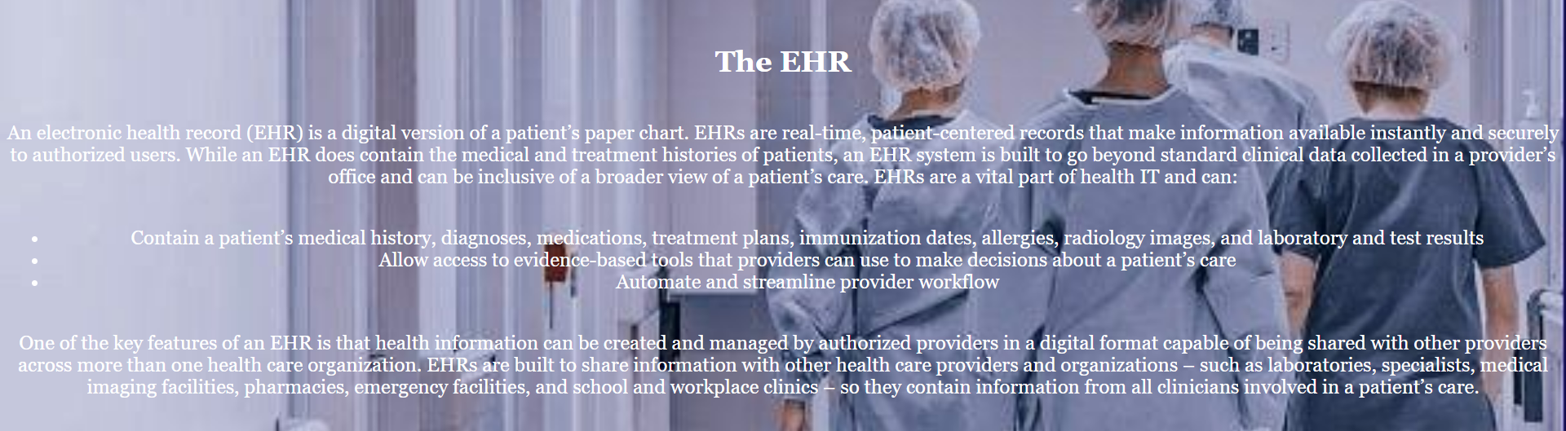
INITIAL MENU

Slide 10
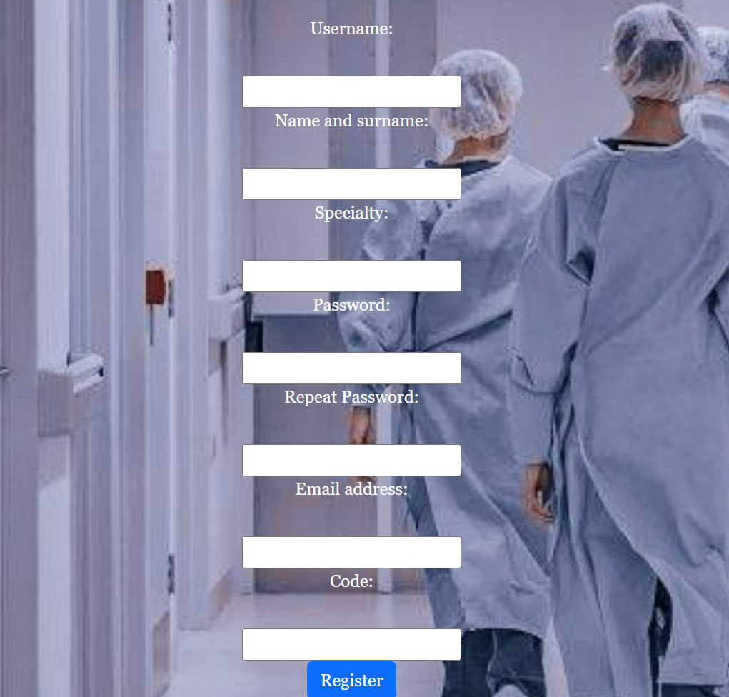
INITIAL MENU

Slide 11

INITIAL MENU

Slide 12

INITIAL MENU

Slide 13
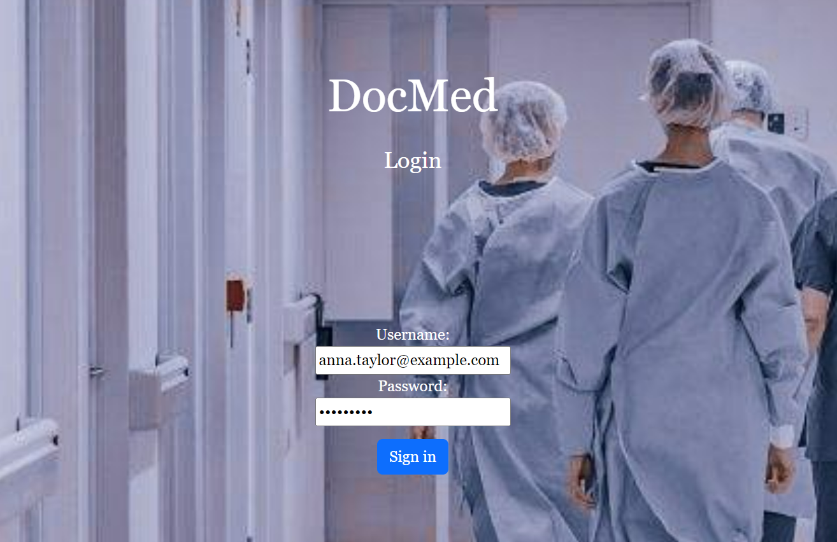
INITIAL MENU

Slide 14
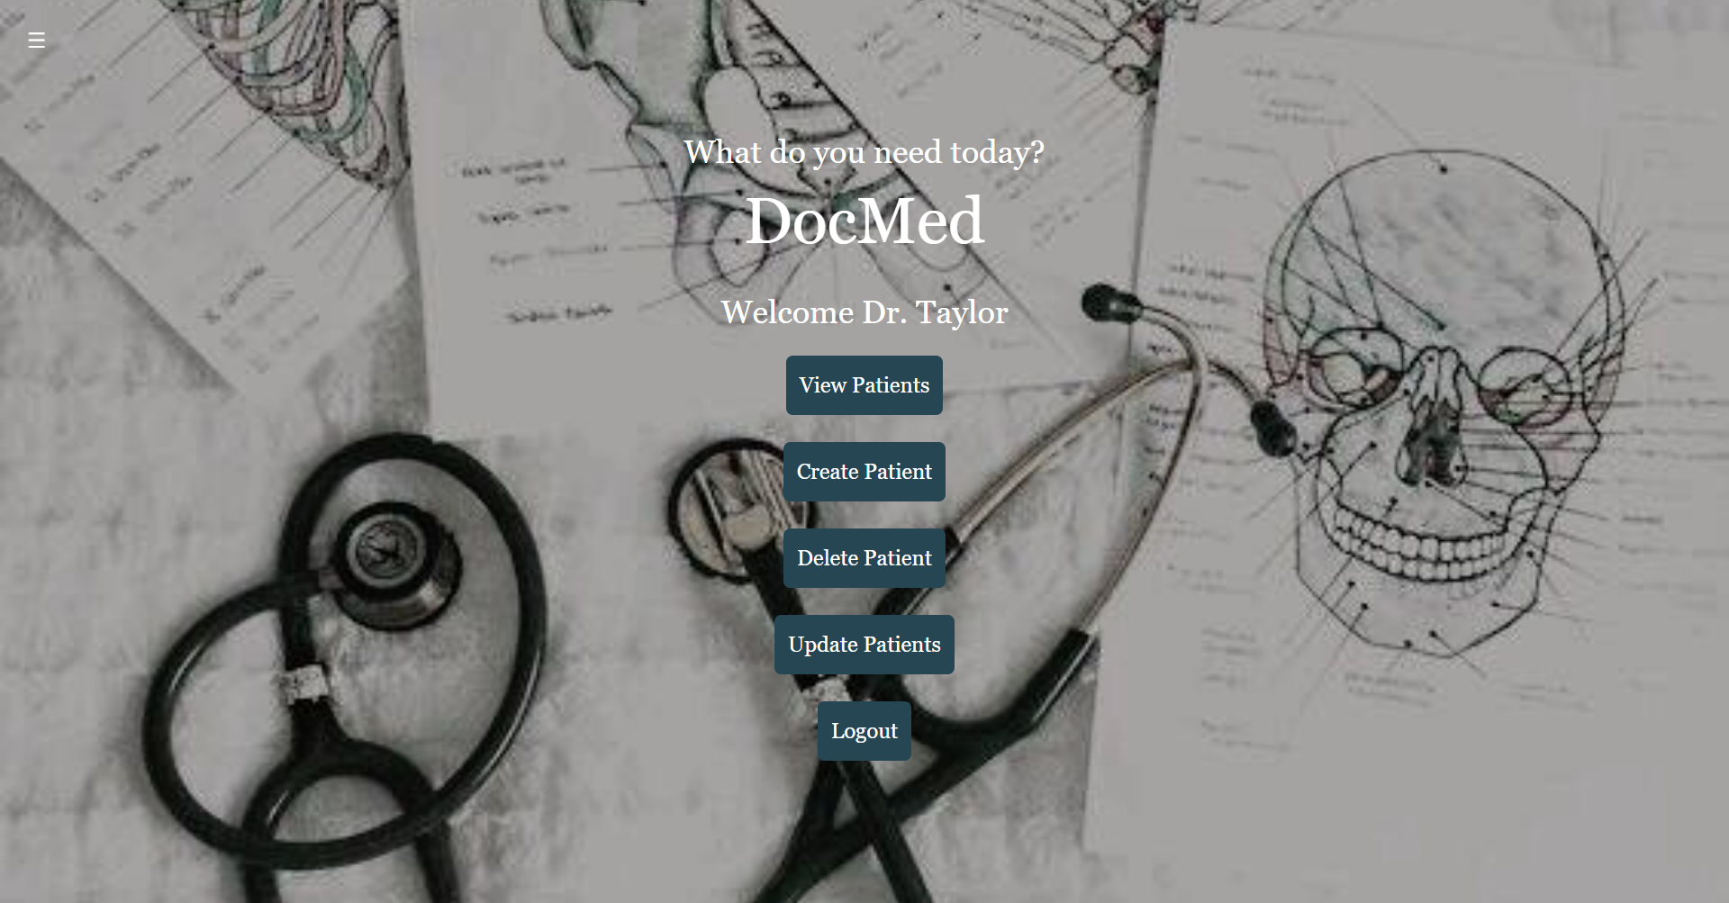
DOCTOR’S MENU

Slide 15
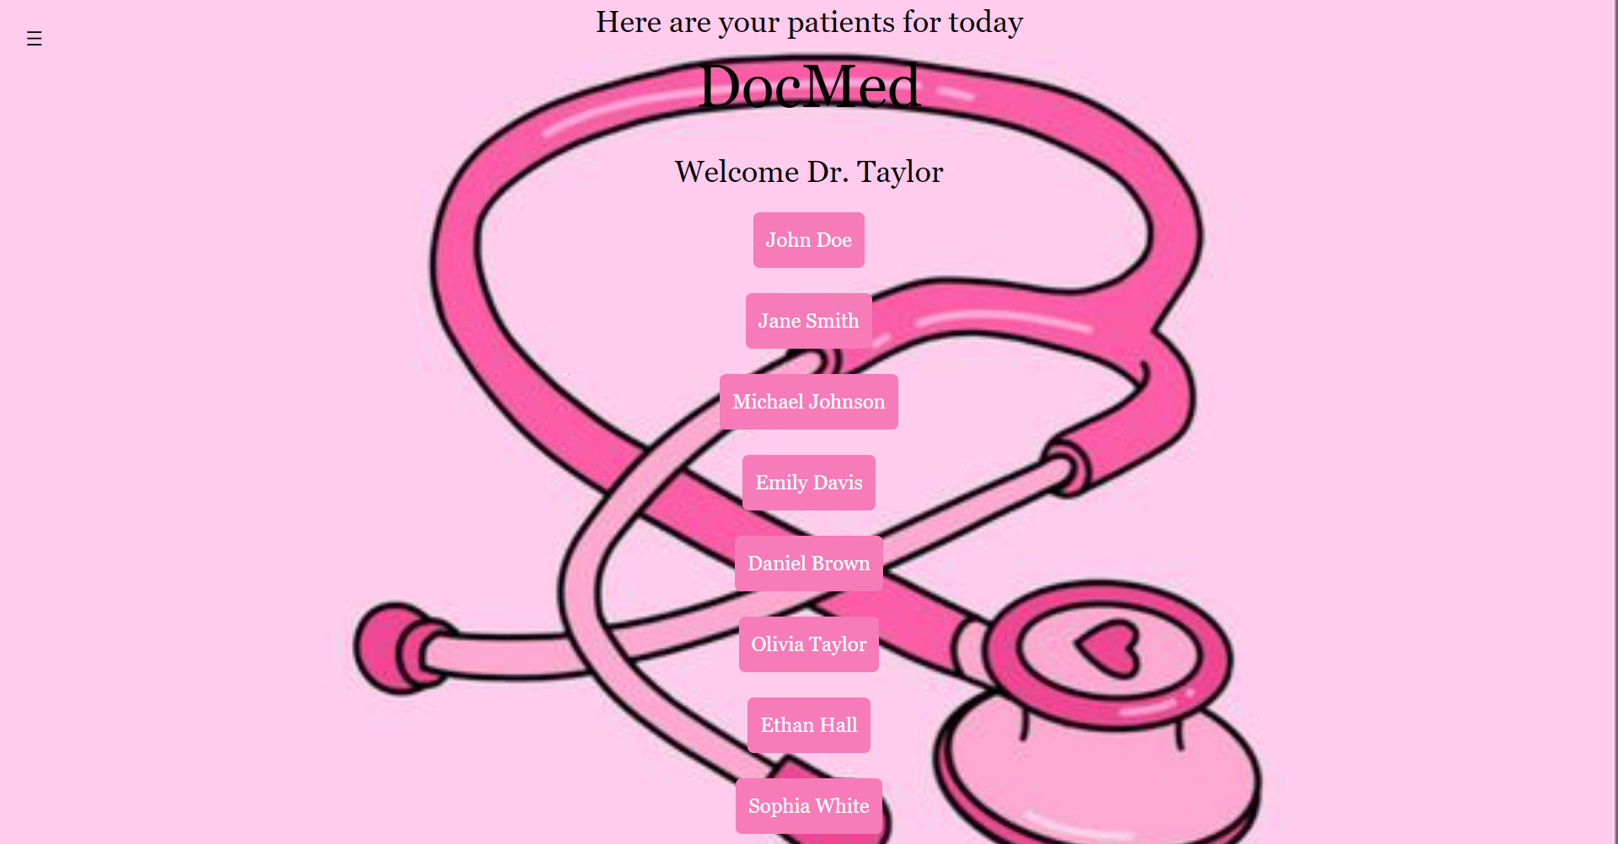
DOCTOR’S MENU-View Patients

Slide 16
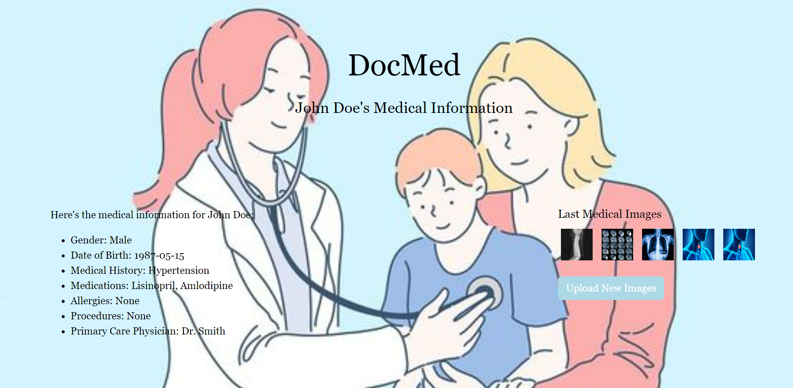
DOCTOR’S MENU-View Patients

Slide 17
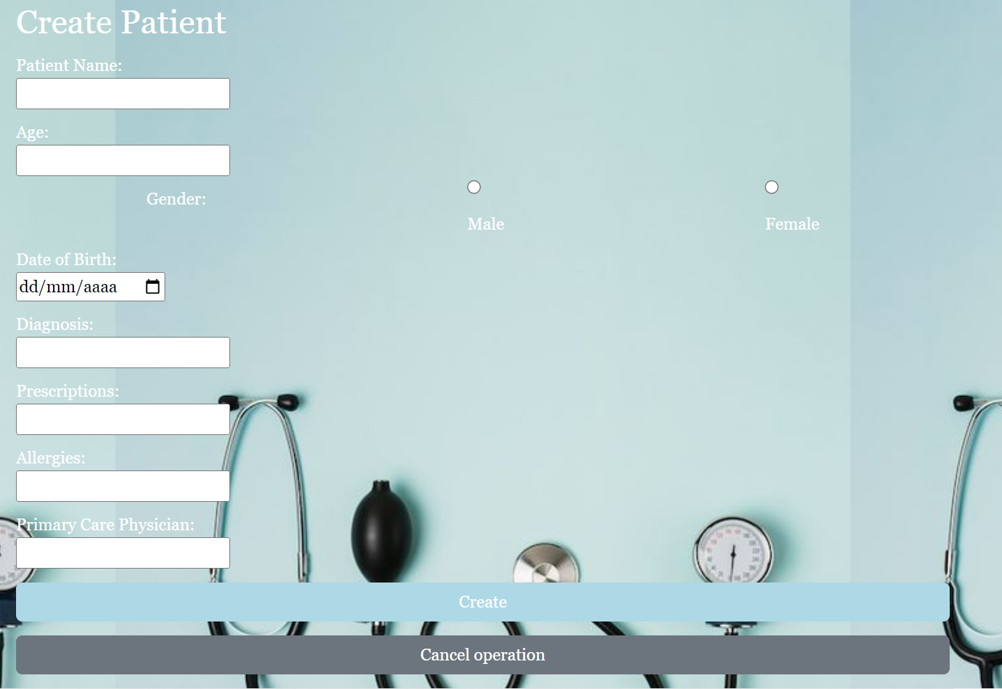
DOCTOR’S MENU-Create Patients

Slide 18

DOCTOR’S MENU-Delete Patients

Slide 19
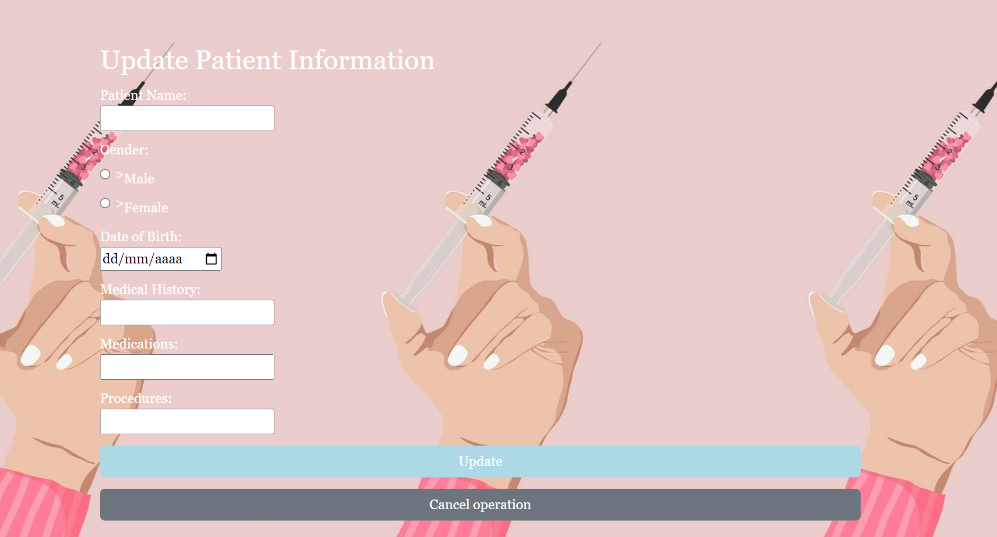
DOCTOR’S MENU-Update Patient Information

Slide 20

DOCTOR’S MENU-Logout

Slide 21
BACKEND
The backend, or server-side, is the part of a software application or website that is responsible for managing and processing data. It includes the server, database, and application logic that operate behind the scenes. The backend handles tasks such as data storage, retrieval, and business logic execution, ensuring seamless communication between the user interface (frontend) and the database. Technologies commonly used for backend development include programming languages like PHP, Python, or Java, along with databases such as MySQL or MongoDB. The backend plays a crucial role in supporting the functionality and performance of the overall system.
04

Slide 22
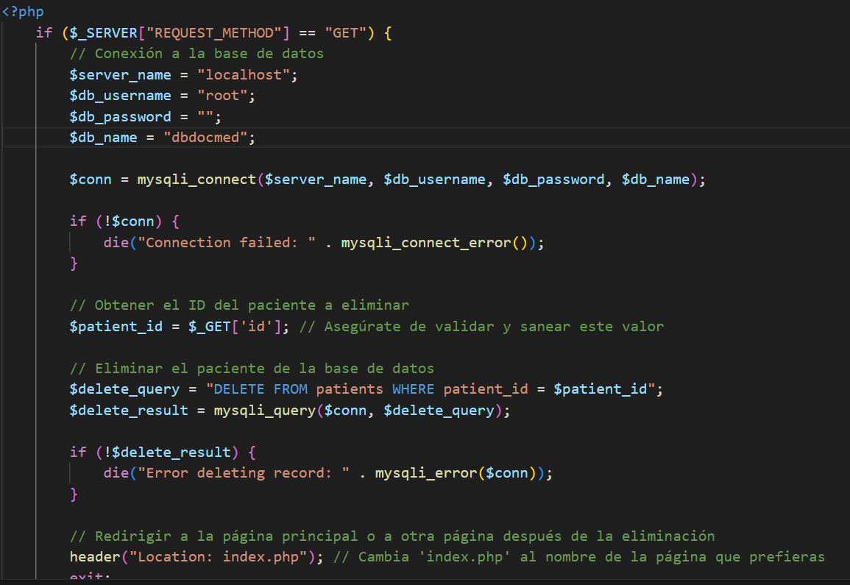
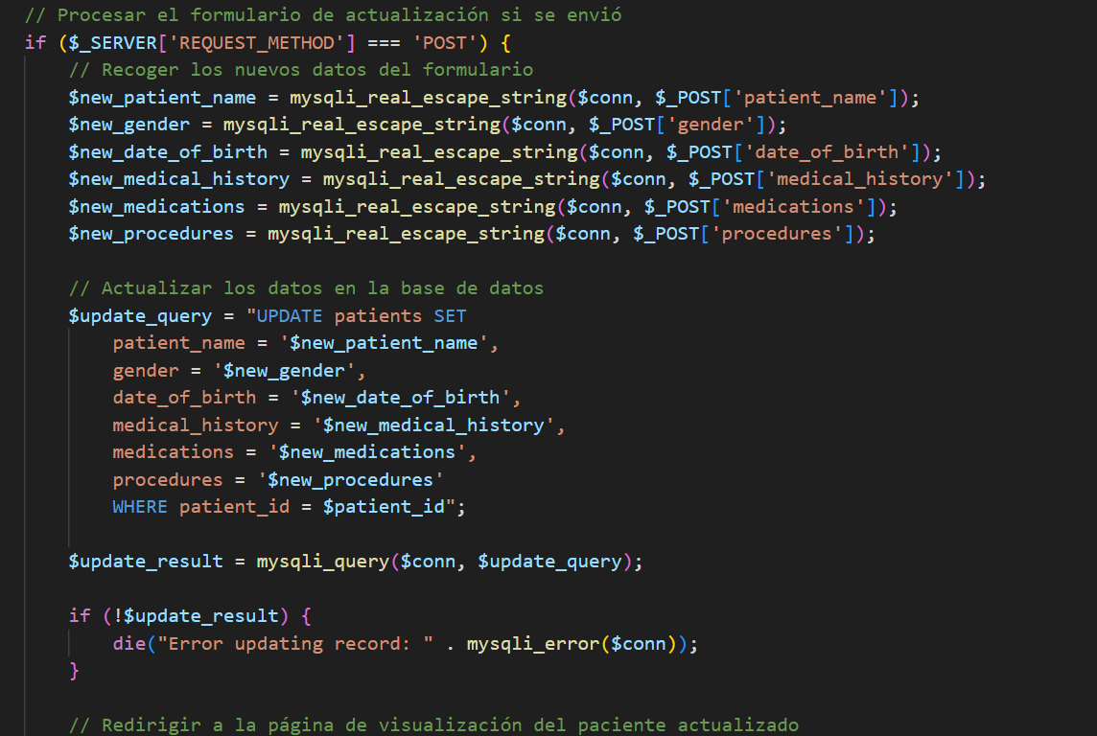
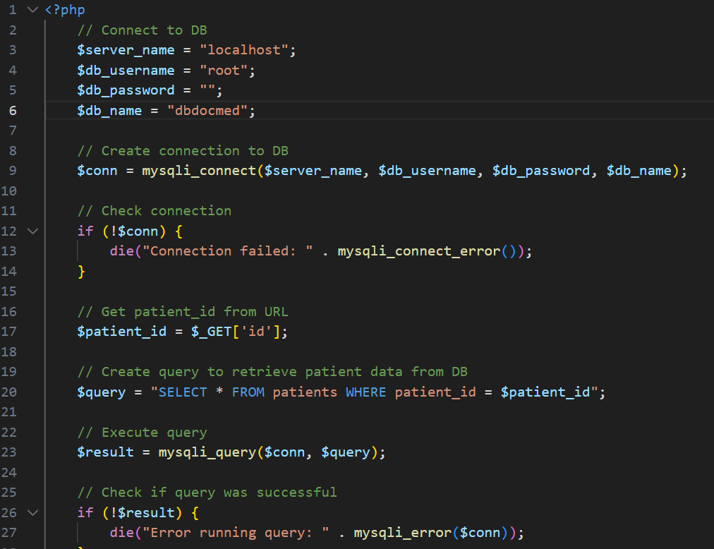
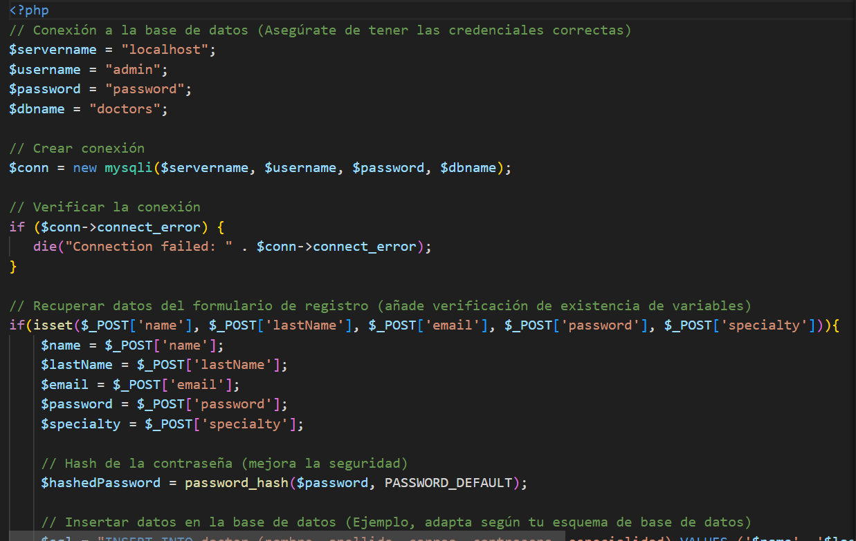
BACKEND
4.01
PHP

Slide 23

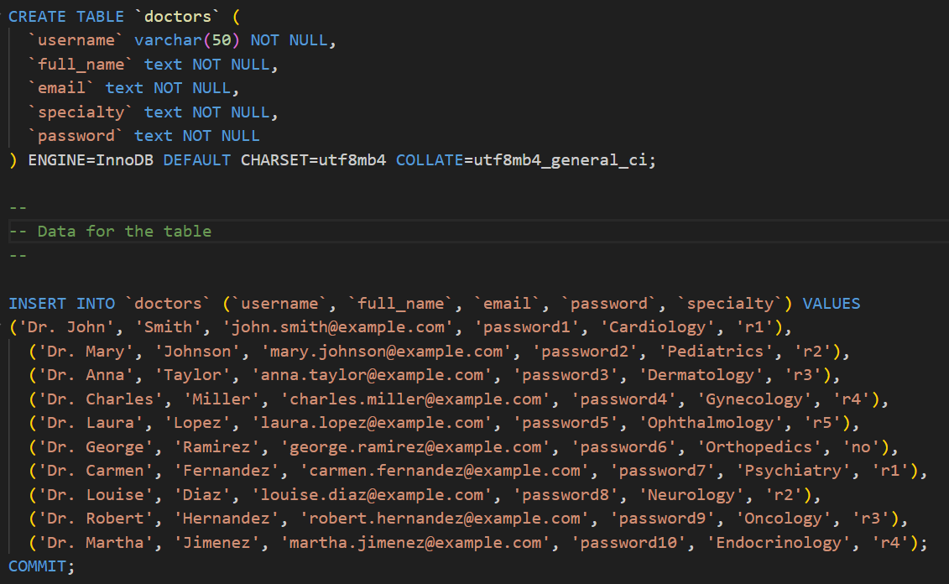
BACKEND
MySQL-Doctors
4.02

Slide 24
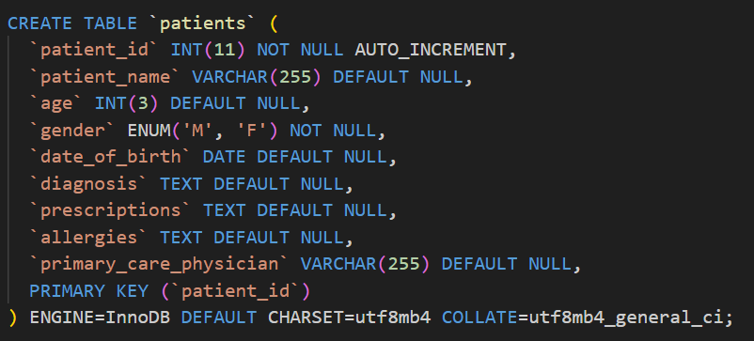
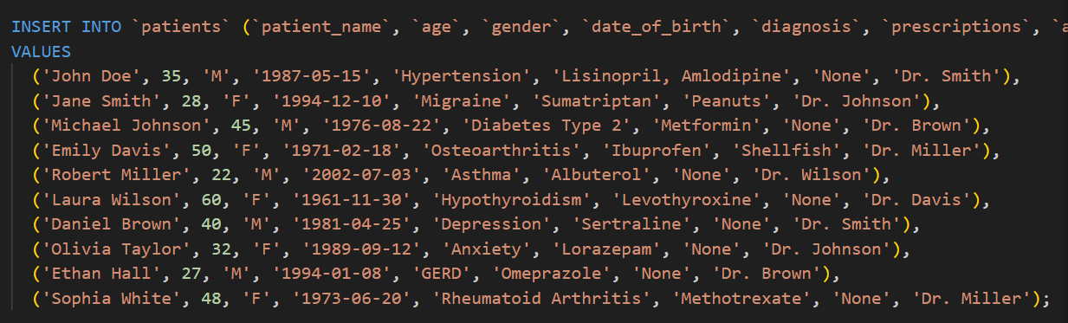
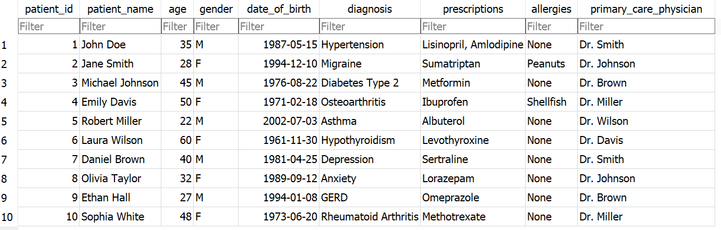
BACKEND
MySQL-Patients
4.02

Slide 25
EVALUATION
Usability Scale:
A usability scale, such as the System Usability Scale (SUS), is a standardized questionnaire designed to assess the perceived usability of a system or product. It typically consists of a set of statements or questions related to user experience, ease of use, and overall satisfaction. Users provide responses on a predefined scale, and the aggregated scores help measure and evaluate the effectiveness, efficiency, and user satisfaction with the system. The usability scale is a valuable tool in user experience research, providing quantitative insights into the user-friendliness and effectiveness of a product or system.
05

Slide 26
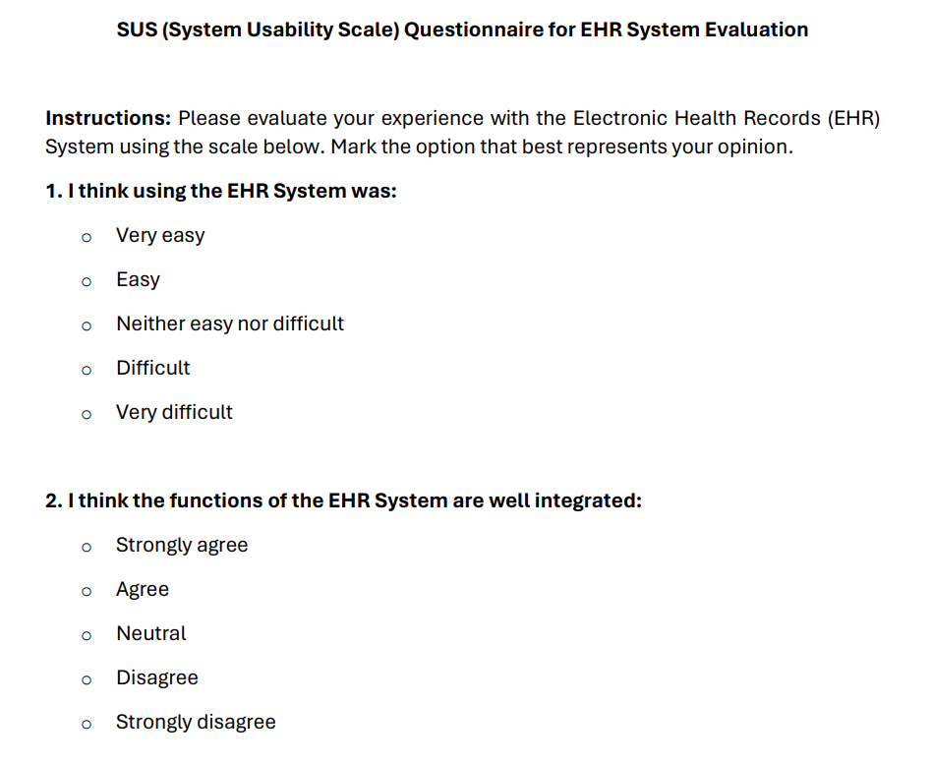
EVALUATION
I think using the EHR System was:
I think the functions of the EHR System are well integrated:
I think the EHR System is easy to use:
I would need to learn to use the EHR System before I could use it easily:
I think I could use the EHR System without the help of another person:
I think the various functions of the EHR System are well integrated:
I think the EHR System was easy to use after learning how to use it:
I would recommend the EHR System to my fellow healthcare professionals:

Slide 27


¡THANKS FOR LISTENING!
ANY QUESTIONS?

